Slide 1
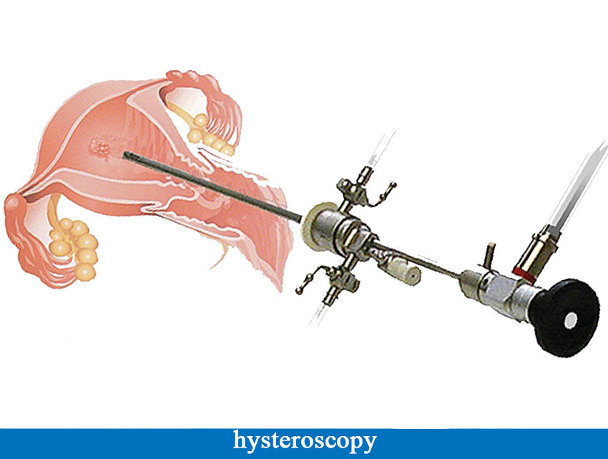
Hysteroscopy
Dr. SHEEBA.S,
DEPT. OF OBG.
ASSISTANT PROFESSOR.

Slide 2
CONTENTS
Definition
History
Instruments
Overview procedure
Indications
As a diagnostic tool
As a therapeutic tool
Contraindications
Risk factors
complications

Slide 3
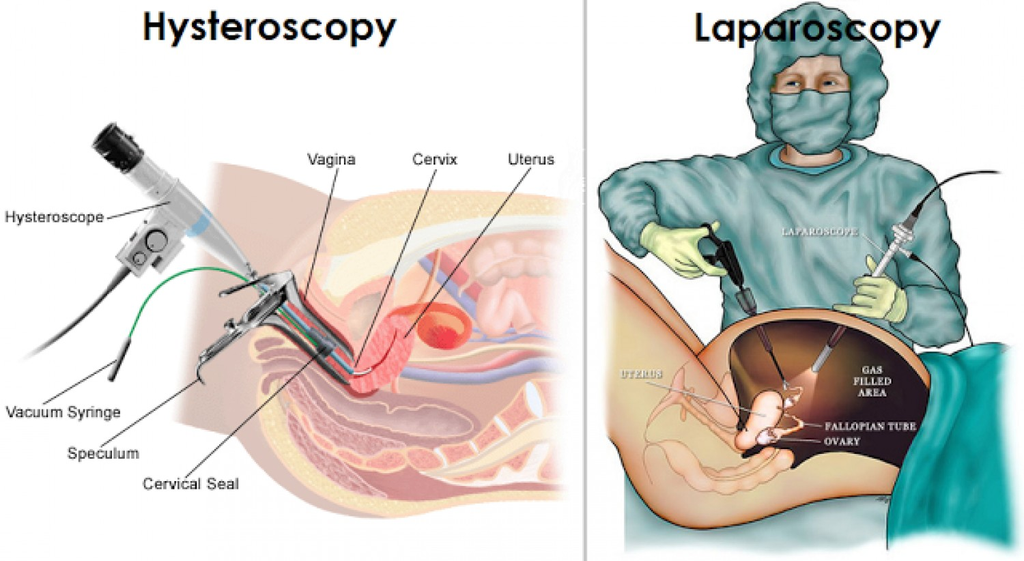

Slide 4
DEFINITION
Hysteroscope is an endoluminal endoscope that can be used as an aid to visualize uterine cavity or to direct the performance of variety of intrauterine procedures.

Slide 5
HISTORICAL ASPECT
Désuormeaux, in 1865, produced the first hystoscope
Pantaleoni in 1869 accomplished the first hysteroscopy using the instrument of Désormeaux. He isolated and cauterized an uterine polyp with silver nitrate.
Nitze, in 1879, drew and produced an endoscope using the modern beginnings.
S.Duplay and S.Clado, 1898

Slide 6
Duplay and Clado, in 1898; David, in 1908; Heineberg, in 1914; Rubin, in 1925; Seymour, in 1926; Van Mikulicz, in 1927; Gauss, in 1928; Schroeder, in 1934; Segond, in 1937; Fourestier, Gladu and Vulmiere, in 1952; Mohri and Mohri, in 1954; Norment, in 1956; Palmer, in 1957; Silander, in 1962; Marleschki, in 1966; Edstrom and Firestorm, in 1970; Lindemann and Mohr, in 1971; Porto and Gaujoux, in 1972; Vulmière, in 1972; Iglesias, in 1975; Lindemann, in 1976; Siegler and Kemman, in 1976; Hopkins, in 1976; March, in 1978 and Sugimoto, in1978-all of them contributed in some way to the technological progress of the method.
Hamou, in 1979, idealized the microhysteroscope with panoramic vision and of contact.

Slide 7
INSTRUMENTS
Hysteroscope:
-Telescope : eyepiece, barrel & objective lens.
Angle options : 0,12 ,15, 25, 30 & 70 degree.
0 degree provides a panoramic view.
- angled one improve the view of ostia in an abnormally shaped uterine cavity.

Slide 8
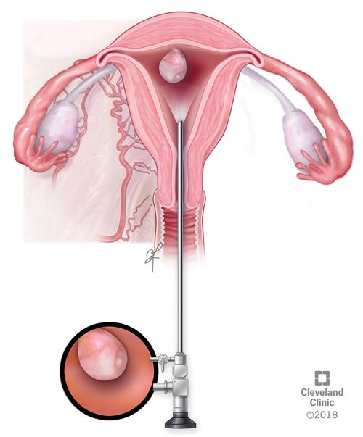

Slide 9
Rigid hysteroscope
- in-patient and complex operating room procedures.
3-5mm in diameter
more durable and provide superior image.

Slide 10
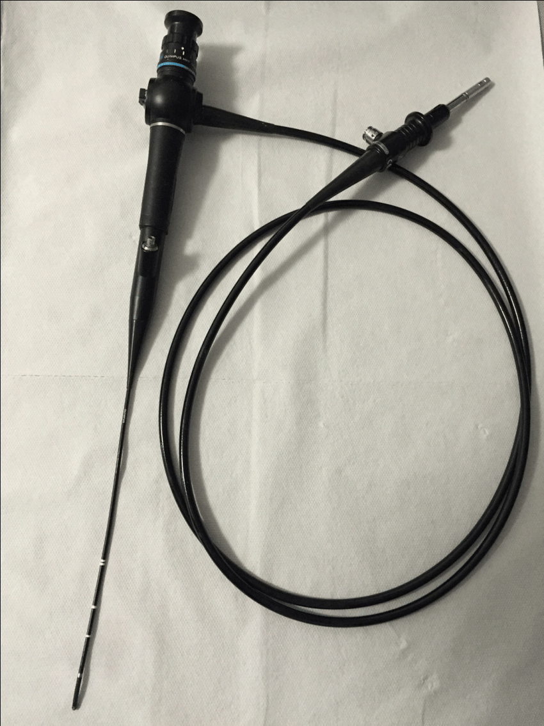
Flexible hysteroscope
most commonly used
for office hysteroscopy
flexibility; tip deflection
of 120-160 degree.
irregularly shaped uterus &
navigation around intrauterine lesions.

Slide 11
Light source.
-halogen and xenon; xenon generator provides white light, which gives a superior color and intensity.

Slide 12
Camera Equipment

Slide 13
Diagnostic sheaths
-to deliver the distention media
-fit by means of a watertight seal lock
- 4 to 5 mm in diameter, with a 1 mm clearance between the inner wall and the telescope, through which the distention media is transmitted.

Slide 14
Operative sheaths
- larger diameter - 7 to 10
- allows space for instillation of medium, for the telescope, and for the insertion of operating devices.

Slide 15
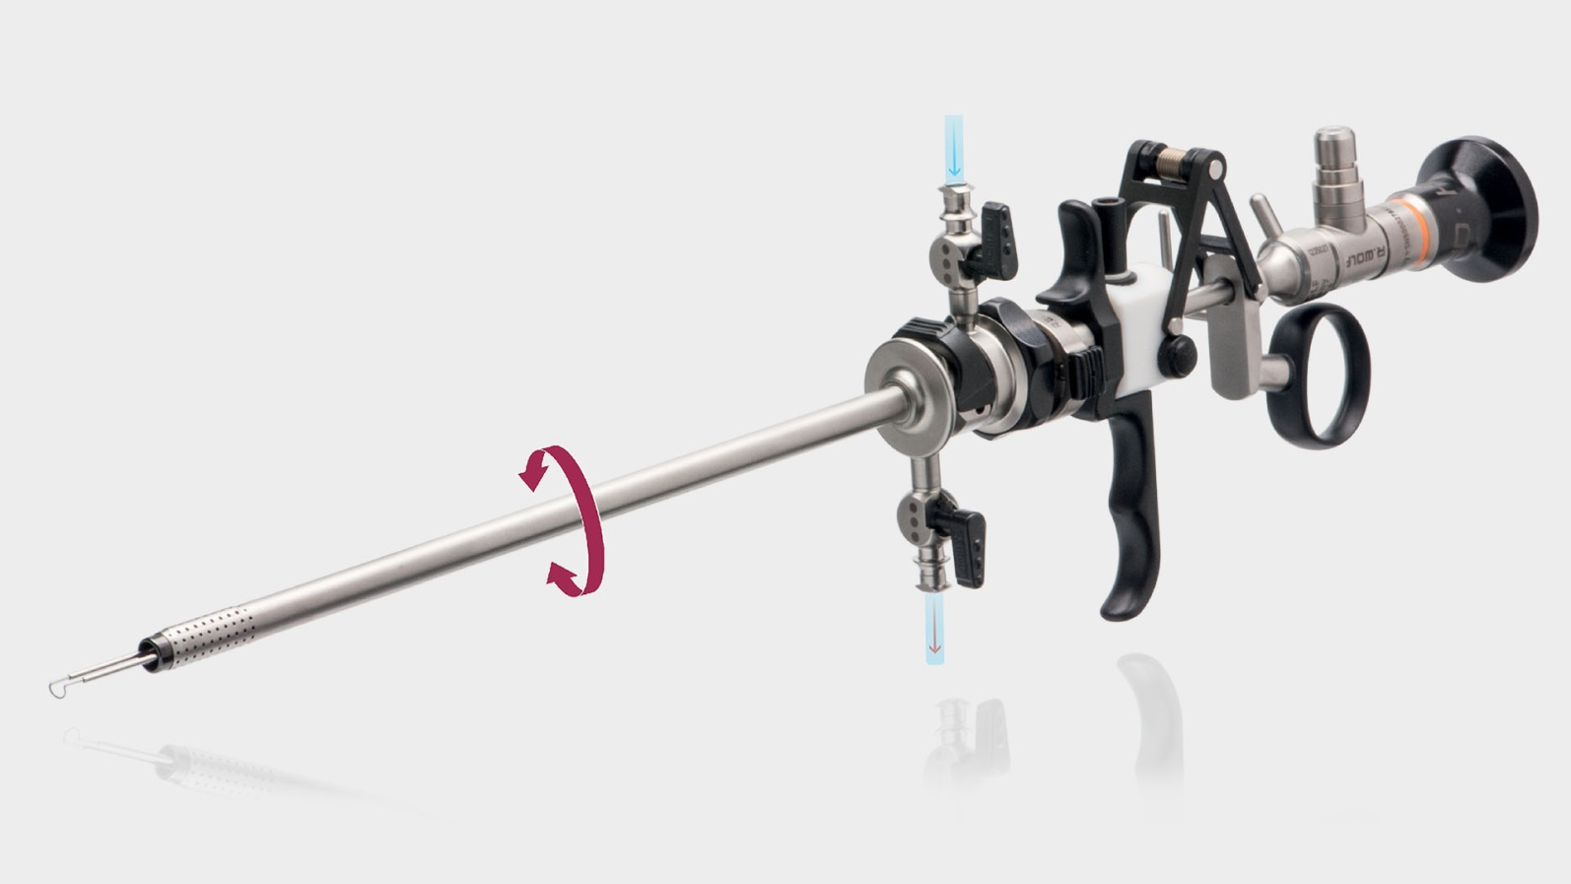
Resectoscope
-three basic electrodes: a ball, barrel, and a cutting loop.

Slide 16
Accessory instruments
- alligator grasping forceps, biopsy forceps, and scissors, morcellator
- monopolar and bipolar electrodes
- A new bipolar system named VersaPoint
(saline may be used as distention media)

Slide 17
DISTENTION MEDIA
-muscle of uterine walls requires a minimum pressure of 40 mm Hg to distend the cavity.
-types of distention media
gaseous
liquid - high-viscosity and low-viscosity fluids

Slide 18
PROCEDURE
The procedure itself takes place in the following order:
Lie on a couch with your legs held in supports, and a sheet is used to cover your lower half an instrument called a speculum may be inserted into your vagina to hold it open (the same instrument used for a cervical screening test), although this is not always needed the vagina and cervix are cleaned with an antiseptic solution
The doctor will dilate (widen) your cervix to allow the hysteroscope to be inserted.

Slide 19
The hysteroscope is inserted through your vagina and cervix into the uterus.
Carbon dioxide gas or a liquid solution is then inserted into the uterus, through the hysteroscope, to expand it and to clear away any blood or mucus.
Next, a light shone through the hysteroscope allows your doctor to see your uterus and the openings of the fallopian tubes into the uterine cavity.
Finally, if surgery needs to be performed, small instruments are inserted into the uterus through the hysteroscope.

Slide 20
The time it takes to perform hysteroscopy can range from less than five minutes to more than an hour. The length of the procedure depends on whether it is diagnostic or operative and whether an additional procedure, such as laparoscopy, is done at the same time. In general, however, diagnostic hysteroscopy takes less time than operative.

Slide 21
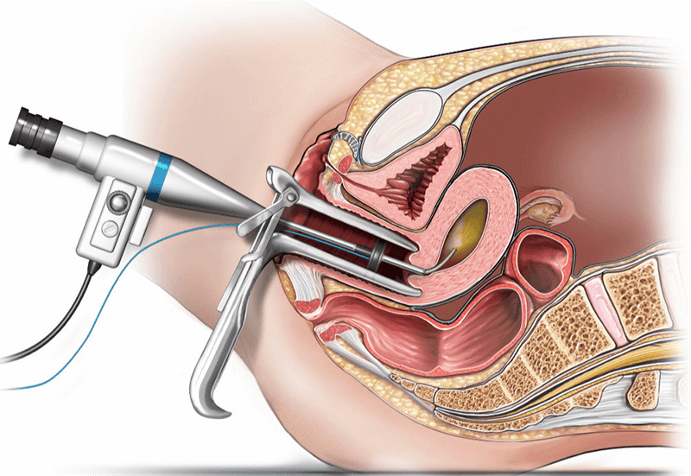

Slide 22
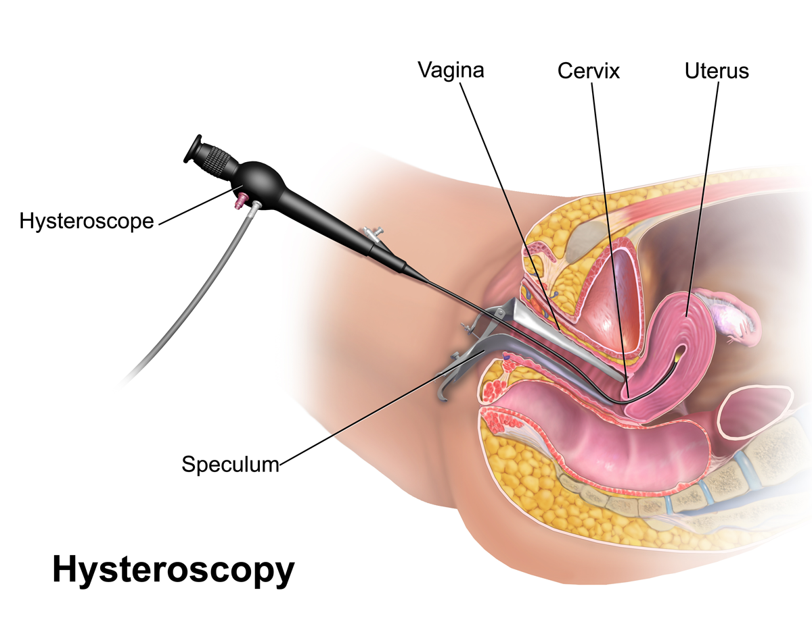

Slide 23
Adhesions.
Septum.
Polyps.
Sub mucous myoma with or without intramural component.
Dysfunctional uterine bleeding resistant to hormonal therapy
Tubal catheterization
INDICATIONS
SURGICAL INDICATIONS:
Adhesions.
Septum.
Polyps.
Sub mucous myoma with or without intramural component.
Dysfunctional uterine bleeding resistant to hormonal therapy
Tubal cannulation
Removal foreign body (intrauterine device).
Temporary and definitive sterilization

Slide 24
UTERINE POLYPS
Multichannel operating hysteroscope is used
Retractable electric snare is inserted which encompasses the base of polyp and is then tightened
Cutting current of 30-40 W is applied
Snare removed and polyp is grasped with aligator jaw forceps
Site of removal is inspected and if any bleeding observed it is coagulated with ball electrode

Slide 25
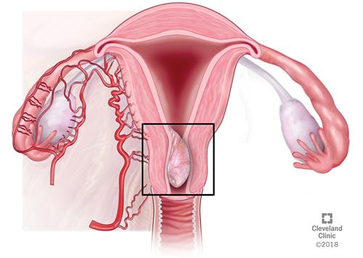
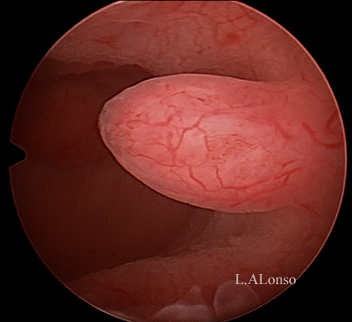
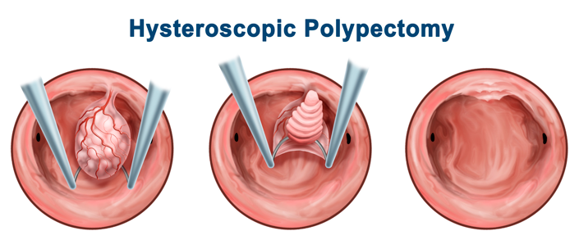

Slide 26
UTERINE SEPTUM
TECHNIQUE
Hysteroscope is drawn to the level just above the internal os and septum is cut from below upwards with simultaneous laparoscopy.
Stop dissecting when both tubal ostia are clearly visible in panoramic view and signal from laparoscopist that fundus is approaching
Post op care
-Foley’s catheter
-conjugated estrogens and
- HSG after 6-8 weeks

Slide 28
INTRAUTERINE ADHESIONS
Trauma
Missed or incomplete abortion, postpartum hemorrhage, or retained placental remnants
Genital tuberculosis Classifications
Endometrial adhesions - filmsy adhesions
Myometrial adhesions – dense adhesions
Connective fiber synechiae
Goal – Restore normal anatomy
Scissors
Resectoscope collins knife for dense adhesions

Slide 30
IUCD REMOVAL
Multichannel hysteroscope with alligator forceps is inserted and string is grasped and drawn along with hysteroscope.
If embedded IUCD is there rigid grasping forceps are used and jaws grab the extruded portion of IUCD and taken out by strong force

Slide 32
HYSTEROSCOPIC MYOMECTOMY
Leiomyomas appear as white spherical masses covered by network of thin fragile vessles
PRE OPERATIVE ASSESSMENT-
-Diagnostic hysteroscopy
-Endometrial biopsy
-Transvaginal ultrasonography

Slide 33
Pedunculated leiomyoma
Partially intramural myoma
Myoma with predominantly intramural development

Slide 34
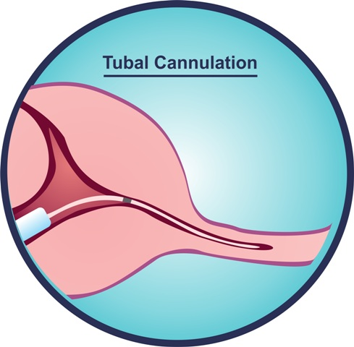
TUBAL CANNULATION
INDICATION
interstitial obstruction
transfer of gametes.
tubal sterilisation

Slide 35
TECHNIQUE
In interstitial obstruction 5.5 F teflon cannula with metal obturator is introduced, obturator removed and a 3F catheter with guide wire is withdrawn and dye injected, dye spilling can be seen via laparoscope.
Gamete transfer is done by 1 mm catheter cannulation. Uterine distension media are toxic to gametes so CO2 is preffered that too at low flow rates and gas flow is shut off when catheter enters the tube.

Slide 37
TUBAL STERILISATION
Hysteroscopic placement of radiopaque inserts in the proximal portion of the fallopian tube
Tissue ingrowth occurs through the insert creating natural barrier
Device Length: ~3.85 cm
PET Fiber Length: ~1.75 cm
Expanded Outer Diameter: 1.5 – 2.0 mm
Inserts are visible by X-Ray, Ultrasound, MRI and CT Scan

Slide 38
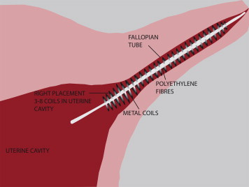

Slide 39
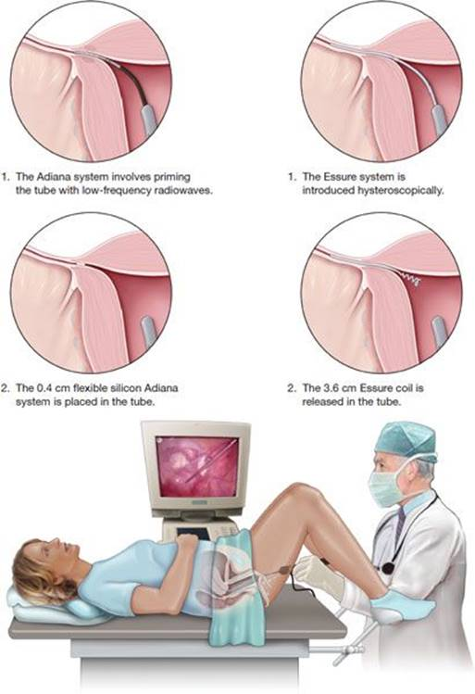

Slide 40
DIGNOSTIC INDICATIONS:
Abnormal uterine bleeding.
Habitual abortion.
Pathology uterine suspicion by other method
Follow-up of uterine surgery, complications of the curetage, trophoblastic disease, uterus-tubal implant.
Bone metaplasia of the endometrium.
Secondary amenorrhea and with negative estrogenic-
progestinic test.
Pelvic pain
Cancer.

Slide 41
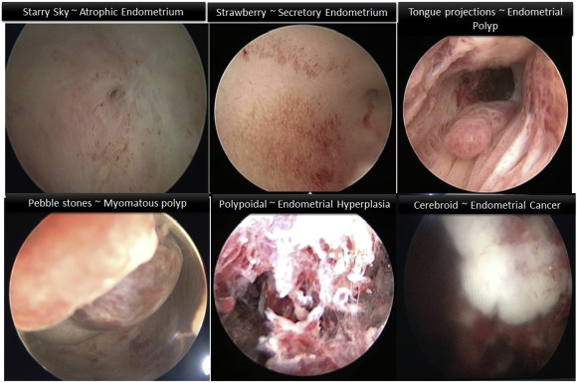
ABNORMAL UTERINE BLEEDING
Abnormal uterine bleeding is a common problem mainly encountered in peri-menopausal and post-menopausal women.

Slide 42
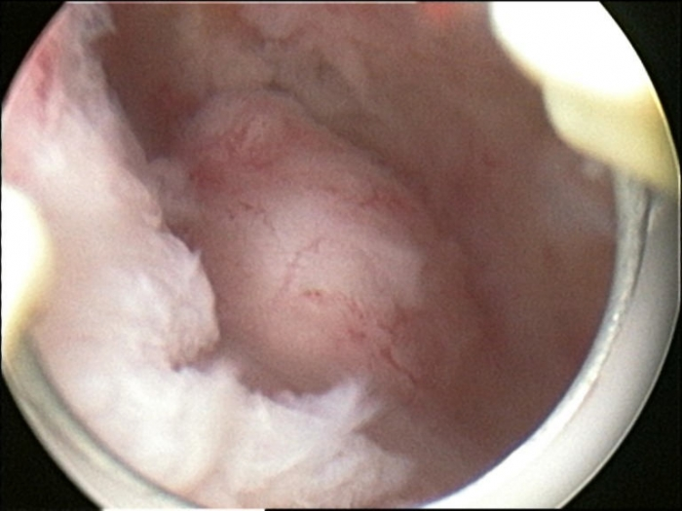
Hysteroscopy, on the other hand, unlike dilatation and curettage is not a blind procedure and can be used as an office procedure.
Hysteroscopic evaluation permits the direct visualization and assessment of the endocervical and uterine cavities, hence proving a reliable method of diagnosing intrauterine abnormalities.Use of hysteroscopy in abnormal uterine bleeding is almost replacing blind curettage, as it “sees” and “decides” the cause.

Slide 43
HABITUAL ABORTION
The incidence of structural uterine anomalies (SUAs) in women with habitual abortion (HA) as diagnosed by means of hysteroscopy.

Slide 44
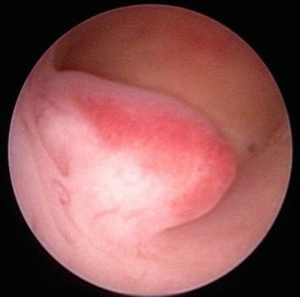
CANCER
Endometrial sampling for histopathology examination is essential to diagnose endometrial cancer. Hysteroscopy provides an accurate evaluation of the endometrial cavity and allows directed sampling of suspected lesion. Hysteroscopy plays a role in the diagnosis of patients with possible endometrial cancer in whom endometrial sampling is unsatisfactory or in those who require a dilation and curettage (D&C).

Slide 45
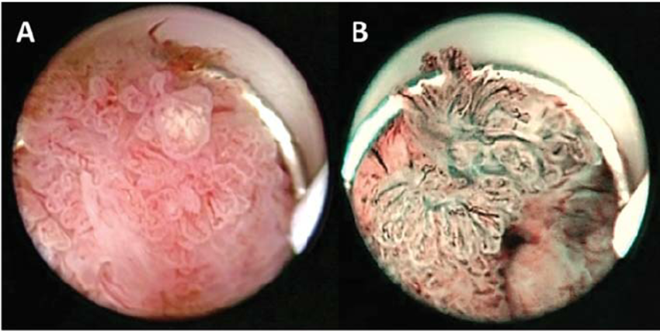
Similar to endometrial biopsy and D&C, hysteroscopy is associated with dissemination of endometrial cells into the peritoneal cavity.

Slide 46
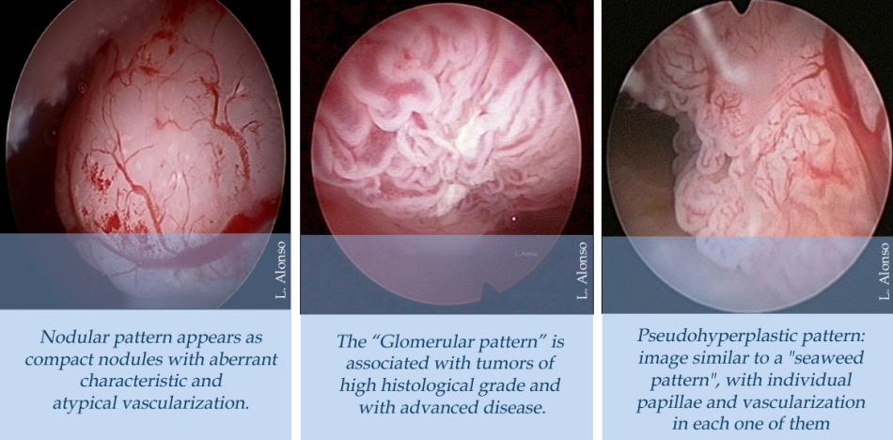
It is usually performed under local anesthesia. The uterus is distended using either CO₂ gas or liquid solution. The use of solution provides a clear visualization of the uterine cavity. In contrast, CO₂ gas and blood will produce bubbles that impair visualization.

Slide 47
Contraindications
Pregnancy.
Current or recent pelvic infection.
Current vaginitis, cervicitis and endometritis.
Recent uterine perforation.
Active Bleeding.

Slide 48
COMPLICATIONS
Secondary To The Gaseous Distension
N2O (nitrous oxide) - lung clot, bradycardia and collapse
CO2 (carbon dioxide) - pain in the area of the scapula bone, due to the stimulation of the frenic nerve, that disappears spontaneously after some minutes. Hypercapnia, acidosis,arrhythmia and cardiac arrest are not more found now with the amount and pressure of the gas used, being recommended a maximum flow of 100 ml/min and a maximum pressure of 150 mmHg.

Slide 49
Secondary To The Distension Liquid
Overload - excessive passage of liquid to the current blood, causing dilution, hyponatremia, arterial hypertension and pulmonary edema, in the postoperative it can cause hypotension and mental confusion. It happens mainly when the operative procedure is long, high pressure of distention, depth of the myometrium dried up above 4 mm and in the luteal phase of the menstrual cycle for the largest vascularization of the endometrium
Anaphylaxis (solution of Hyskon).
Encephalopathy (glicina).
Hyperglycemia (glucose and sorbitol).
Hemolition (distilled water).
Air embolism

Slide 50
Infectious
Endometritis
Salpingitis
Pelvic inflammatory disease
Traumatic
Cervical trauma (laceration by Pozzi or during the dilation)
Uterine trauma (perforation, more frequently happening in the surgical intervention)
Intestinal trauma, vesical trauma, ureter and great vessels trauma (direct or indirect, this being caused by eletrocoagulation).

Slide 51
Haemorrhage (intra & post-operative)
Synaechia
Hematometra, cryptomenorrhea and recurrent pain(it happens mainly in the total ablation of the endometrium).
Pregnancy after ablation of the endome trium, causes abnormal
placental insert and IUGR
Painful
Vagal Reaction
Bradycardia
Sensorial alterations
Syncope
Cardiac arrest
Anesthetic :Allergic reactions, Arrhythmia, Convulsions
Flaws therapeutics ( 10% – 20%)
vaginal secretion for 2 to 4 weeks

Slide 52
Prevention of adhesion formation:
Second or third look hysetroscopic adhesiolysis.
Barrier methods (sepra film,amnion graft)
Mechanical methods (IUD, lippes loop, foley’s balloon)
Hormone treatment (estrogen, progesterone, GnRH analouges)
Pharmological agents( antibiotics, antihistaminics, NSAIDS)

Slide 53
ADVANTAGES OF HYSTEROSCOPY
Shorter hospital stay.
Shorter recovery time.
Less pain medication needed after surgery.
Avoidance of hysterectomy
Possible avoidance of "open" abdominal surgery.

Slide 54
DISADVANTAGES
Risks associated with anesthesia.
Infection.
Heavy bleeding.
Injury to the cervix, uterus, bowel or bladder.
Intrauterine scarring.
Reaction to the substance used to expand the uterus.

